Slide 1
BHF DR Process
December 10, 2021
Enterprise Architecture

Slide 2
Version Control
Version | Date | Author | Description
1.0 | 10/12/2021 | Sasikumar Sampath

Slide 3
Contents
Design Review Overview
Design Review Process

Slide 4
Requirement : Target within 8 hours from disaster occurred to user availability
Disaster occurred
End user can use system
8hours
DR team
Cloud team
Basis team
Need to estimate how much hours we need?
Stop PE1 on primary site
HSR takeover (in// with cloud)
Change the parameter (DBhost name) (dependency with ASR)
HDB user store(in// with cloud)
Change global allocation limit (dependency with ASR)
Stop QA1 system
Start PE1 on DR site
Related parties :
GERP Cloud team, Basis team and current operation team
( DR team )

Slide 5
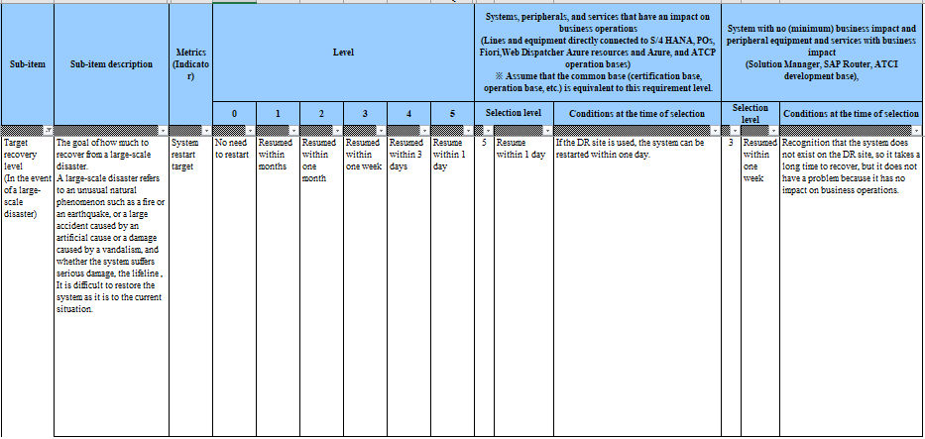
5-2.Disaster recovery Confirm non-functional requirements
The items related to DR in the definition of non-functional requirements are as follows

Slide 6
5-2.Disaster recovery Confirmation of basic requirements
Describe basic requirements for DR.
Requirement
DR Uses site
Establish DR sites to prepare for disasters
It is constructed by dividing it into Primary sites and DR sites, and the DR site ensures the composition of spec equivalent to the Primary site.
The scope of construction of DR sites is limited to the production environment.
Proper use of region
Primary Site/DR Sites Select Different Regions
Normally: The production system is build in East Japan region and the development and verification systems are build in Western Japan region.
When DR starts operations in Western Japan region
Switching to DR sites
Data copies from Primary sites to DR sites in principle and synchronized between sites
Make maximum use of Azure services for data copy site switching as a measure against disasters
For HANA with a large cost impact, when DR is activated, data synchronization is usually attempted using HANA instances of the verifier's Azure.
System restoration targets
Target within 8 hours from disaster onset to user availability

Slide 7
5-2.Disaster recovery DR options
Service-level
Availability maintenance cost
This paper describes basic options for DR realization, RPO, RTO, cost image and realization method.
Option
① Hot standby
② Cold standby
③ Backup & lister
Configure the same number of servers in the same space and standby in constant operation.
Normally shut down to limit operating costs and to operate at emergency
Main sites should be synchronized as much as possible.
Configuration that runs in an emergency and lists the most recent backup VM and backup data available
DR configuration
Image
Normal
Time of DR activation
Normal
Time of DR activation
Normal
Time of DR activation
※ Site switch only (East-West switch with DNS)
Termination release
Start after listing
RPO/
RTO/
Cost
High
Low
Stop
High
Low
several tens of minutes
Several hours
several tens of hours
Adopt
^{Imple-}
^{mentation}
^{Method}
^{AP Server}
・ Run at all times, and reflect changes in the same way as the main site in the event of a configuration change.
・ Stopped and synchronized by ASR
・ Restore from the most recent backup. Setting and reflection after backup should be manually
Adopt
^{DB}
^{Server}
・ Always running and synchronize with DB applications
・ For the system (binary) area of the DB, the same as for AP (if there is a configuration change, the same changes as for the main site are reflected).
・ Stops and cannot be synchronized, and after startup DB application synchronization may be regularly invoked depending on the required data volume for replications.
・ For the system (binary) area of DB, as in AP
・ List from the most recent backup. Manual for setting and reflection after backup

Slide 8
5-2.Disaster recovery Selection of system-specific DR methods
Select the DR method for each system and summarize the level of non-function requirements.
Application system |  | DR method |  |  | Requirement
 |  | Hot standby | Cold standby | Backup & restore | Non-functional requirement level Goal of system restart | Supplementation
SAP S/4HANA +Fiori | DBMS(HANA) | ○ | ー | ー | 5: Restart within 1 day | Within 8 hours
 | ASCS+AP | ー | ○ | ー | 5: Restart within 1 day | Within 8 hours
IF server |  | ー | ○ | ー | 5: Restart within 1 day | Within 8 hours
Web Dispatcher |  | ー | ○ | ー | 5: Restart within 1 day | Within 8 hours
SCP connector |  | ー | ○ | ー | 5: Restart within 1 day | Within 8 hours
SAP Solution Manager |  | ー | ー | ー | ー | Do not adopt DR configuration
SAP Router |  | ー | ー | ー | ー | Do not adopt DR configuration

Slide 9


5-2.Disaster recovery DR image of S/4HANA
Legends
Server (VM)
DB
DB system area
Disk
Data
DB data area
ASR(Azure Site Recovery) and Replication synchronize data from East Japan to West Japan region, and provide services in West Japan when DR is declared.
Applications servers use ASR, and DB use DB-Replication to synchronize the data (applications is COLD, DB is HOT standby)
Start application server in West Japan when DR is declared
East Japan
West Japan
PRD system
DR system (QAS HANA server is shared)
AP server
ASR
DB server
Replication
(The system area is changed and reflected in the manual.)
DB
DB
Disk for DR
in QAS HANA server
Data
Data
HANA behaviour
Replication the data of the PRD unit only to the Disk of DR area of QAS HANA server.
When the DR starts, the QAS data-loading is stopped, and PRD/DR data is loaded into the Data area (memory) of the QAS HANA server.
PRD
DR
QAS
HANA
HANA
HANA
Data
Data
Normal time
Time of DR activation

Slide 10


5-2.Disaster recovery ① Hot-standby Realization Image-DB server
(1) Hot standby synchronization image in the DR realization method-DB server image is as follows
The server on the DR site always starts and replicates data from the secondary server at the main site to the DR site in DB applications.
On the main site DR site as well as on the image of the hot standby AP server for the system region of the DB server Reflect changes
When DR is in operation, only network switching is used.
East Japan
West Japan
DB server
DB server
Primary
Secondary
Configuration Change
copied
(Manual Synchronization)
Active
Standby
Active
DB replication
(synchronized at several minute intervals)
Active-Standby redundant configuration
Legends
Server (VM)
Instance
Disk

Slide 11
5-2.Disaster recovery ② Cold Stand-by Realization Image-AP Server
(2) Cold Standby Synchronization in DR Realization Method-AP Survival Image is as follows
Usually the DR site server is stopped and synchronized by ASR
At DR, after network switching, the server starts up and starts operation.
Eastern Japan
Western Japan
S4HANA AP
S4HANA AP
Active
ASR synchronization
Inactive
Legends
Active-Standby redundant configuration
Server (VM)
Instance
Disk

Slide 12
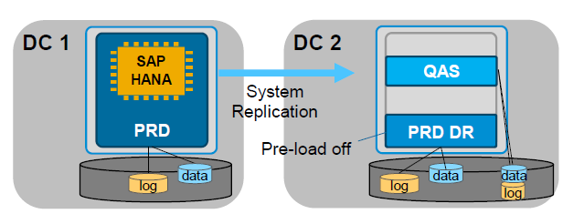
Reuse Secondary Hardware for Non-Productive SAP HANA Systems W/ HSR
Secondary Servers with SAP HANA System Replication can be used for Non-Productive Systems under the following conditions:
Running QA/DEV and using the resources of the secondary HW, the secondary shadow HANA instance cannot be prepared for the take-over (preload of table structures) and the take-over times will be considerably longer.
Preload must be switched off in secondary (preload_column_tables=false)
Possible with single node and scale-out
Non-Productive systems must have their own disk infrastructure
Non-Productive systems have to be turned off with takeover of the productive system
Approx. 10% of system resources are still needed for system replication on the secondary hardware with most restrictive setting.
Memory demands of the systems on the target host must be satisfied by setting allocation limits for all systems. System replication requires approximately: minimum value of 64 GB or “row store size + 20 GB” if this value is higher.

Slide 13
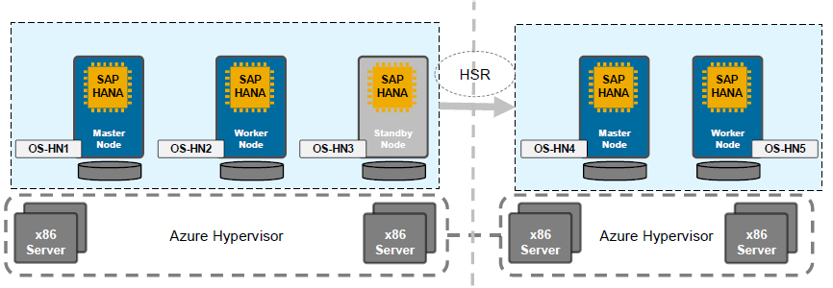
Hostname strategy and DR connection
HA/DR Architecture based on replication (With DNS Redirection)
Hostnames:
–HANA HNs:
1.OS-HN<xx>; (physical), –Used for HANA installation, HANA internal communication, client communication (e.g. AS, Studio, Cockpit, BI Tools), HSR Communication.
Structure:
–HN resolution entirely done via DNS
–HANA replicated via HSR
–HANA access after failover via new OS-HN<xx>
–Client redirection requires manual adaption of client connection strings to new hostnames (Application Servers, BI Tools, HANA Studio, HANA Cockpit)
–SAP AS (PAS/AAS) access to DB after failover to DC2 via different hostnames from primary site or secondary site
–Adjust Domain link after starting Apps on secondary ( This needs to be tested)

Slide 14
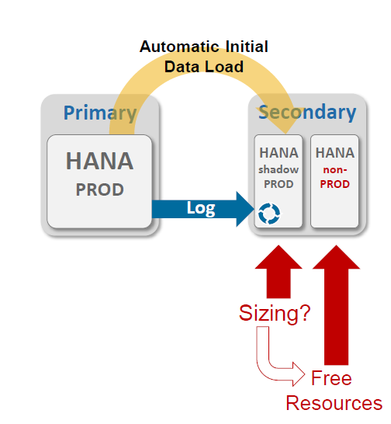
Hardware Re-Use on Secondary / Multi-purpose hardware
In specific situations, it may be possible to re-use the secondary hardware to run a non-production system, for example if the secondary only serves for DR and is operated with data pre-load off.
In this case, the memory demand of the HANA secondary might limit the re-use options for production-size systems on the secondary hardware.
The memory demand of the secondary depends on the log transfer mode and data load option and is given on the following slide.
–Log Replay requires approx. 50% of RAM on the secondary according to the following sizing formula:
RAM of secondary ≈Size of loaded column tables (in-memory) + RowStore size + 50 GB (for log replay operation)
Additional deployments (non-production systems) on HA/DR server requires additional storage space for log and data volumes for these systems.

Slide 15
EISAI DR Solution
Production Design :
East Japan
West Japan
Production ( Primary Site)
HANA System Replication
Production ( DR Site)
Quality (QH1)
SID – PH1
Instance Number – 10
Hostname - HOST1
SID – PH1
Instance Number – 10
Hostname – Host2
SID – QH1
Instance Number – 00
Hostname – Host2

Slide 16
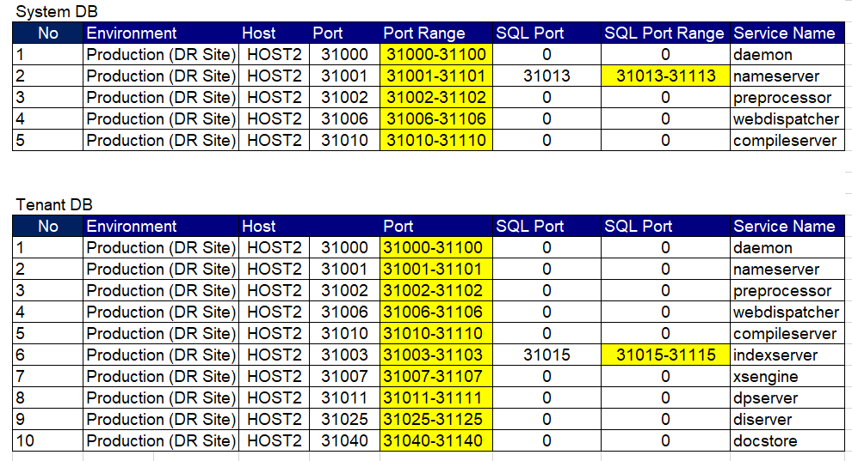
Ports used by PRD HANA during HSR

Slide 17
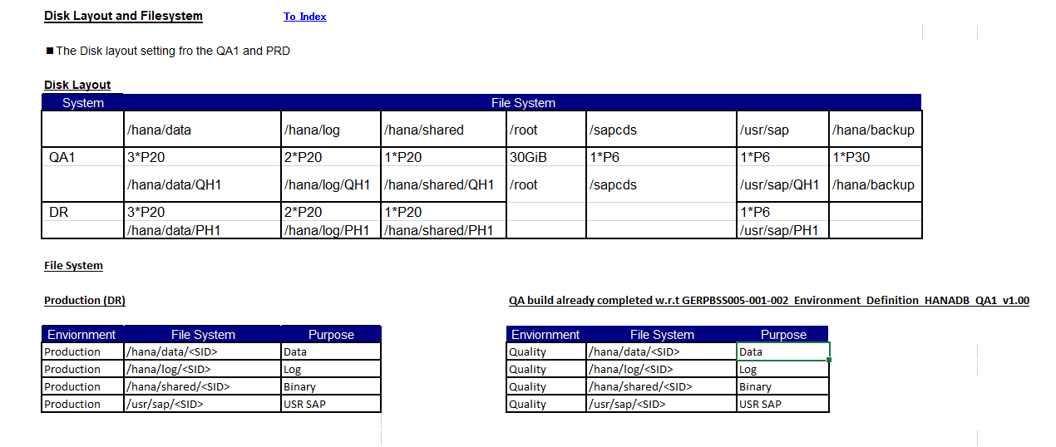
DR Design – Disk layout and file system

Slide 18
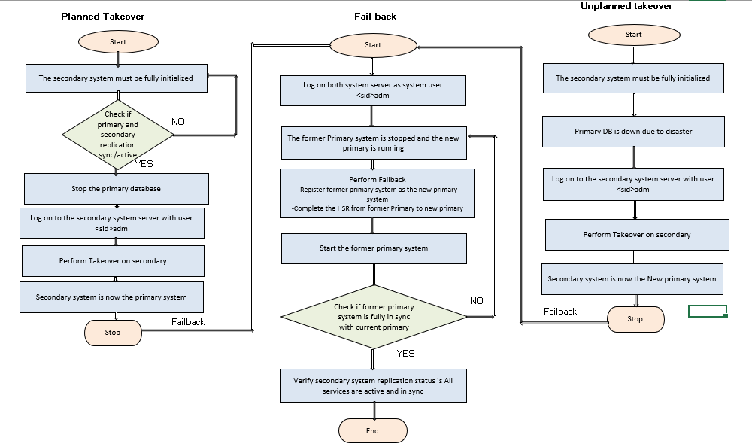
DR Design – Takeover and Failback

Slide 19
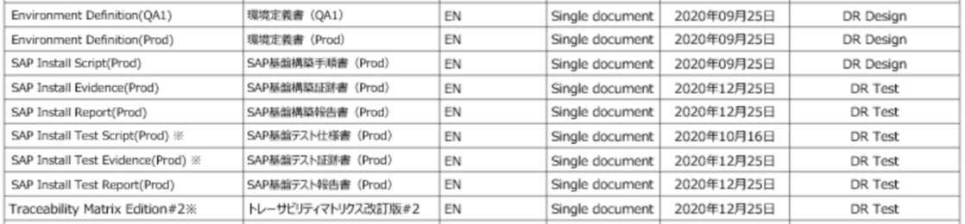
Open Points
RPO & RTO consideration as per NFR
28/8 : 8 hours RTO, need to confirm RPO ???
ASR VM provisioning during disaster ?? Will discuss with cloud team.
Do we need to enable workaround.
Filesystem layout for DR on QA VM – Need to reconfirm with cloud
List of Deliverables for DR , both Cloud and Basis
Env def for HANA_v3
PRD IQ_ v3 ( will add steps for DR)
PRD OQ_ v2 ( will add DR tab)
DR Plan and Schedule ( not deliverable)
Can we simulate actual unplanned DR scenario to understand RPO/RTO SLA?? Need to confirm with cloud team
May be by stopping primary servers without prior notification.

Slide 20
Design Review – Overview What are they and why do we need them?
Design Reviews-WHAT
Design reviews are collaborative sessions where technical requirements or designs created by delivery teams are reviewed by architects and other delivery teams. The sessions confirm that technical requirements or designs created by the application, infrastructure, security, data & analytics and BI/reporting delivery teams match the solution architecture. Design Reviews are: A required step in the SDLC process where sign off is required Scheduled and hosted by delivery teams Presented by Technical Leads (or their representatives) Attended by Solution and/or Domain architect(s) and Delivery Partners
Design Reviews-WHY
Design reviews ensure cross functional, continuous engagement as well as traceability of technical requirements and design to architecture. They support adherence to timeline and avoidance of production issues and technical debt. Delivery teams have experienced negatively impactful issues later in the project lifecycle without them. Design Reviews also: Provide a clear roadmap for build teams Enforce accountability & consistency thru the technical requirements or design artifact and sign off process Allow partner provider teams to be engaged early enough to properly socialize their technical requirements or design Maintain and establish technology governance required by TMO, release management, internal & external audits

Slide 21
Design Review – Overview When and how do they happen?
Design Reviews-WHEN
Design reviews occur after solutions have been approved by the ARB and are in the design phase of the SDLC or when change requests and emergency deployments are in the design phase.
Design Reviews-HOW
Design Review Engagement Model
1. Develop Conceptual Architecture
2. Develop L1 Architecture
3. Develop L2 Architecture
E
Enterprise Architecture
I
IT Infrastructure
S
IT Security
2. Present L1 Architecture to ARB
3. Socialize L2 Architecture
A
Application Team
D
Data & Analytics
2. Socialize L1 Architecture
4. Develop Technical Design
5. Review Technical Design

Slide 22
Design Review Process What is the process?
Solution Architect
Start
Socialize ARB-approved L1 Solution Architecture
Socialize L2 Solution Architecture
Review Technical Design(s)
Schedule Technical Design Review Session(s)
Present Technical Design(s)
Design
Matches
Architecture?
Architecture
Changes
Required?
Update
E
KDD - Key Design Decision
Solution Architecture
N
Y
4
2
Y
N
Technical Debt
Record Deviations in Design Review Findings
Present to Chief Architect
Disclose to ARB
1
Delivery Team
IT infrastructure tech leads
security tech leads
application tech leads
data & analytics tech leads
Initiate Development
Resolve before Go-Live?
`
N
Develop Technical Design(s)
End
Y
I
S
A
D
Update Design
3
Chief Architect / ARB
Y
E
Review Updates
Present
to
ARB?
Solution
Approved?
N
Exception Mgmt. Process
N
End
Y
1
2
3
4
Deliverables
Technical Design Document (s)
Minutes of Design Review
Updated Design
Updated KDD, Solution Architecture, Tech Debt
Technical Design Document

Slide 23
Design Review Process Who are involved and what are the templates?
Design Reviews-Requirements/Templates
Technical leads (or their assigned representatives) create technical requirements or design documents using the Design Templates below and present them during the review. Attendees review them and give feedback.
Team
Technical Leads
(create & present)
Team Members
(attend & review)
Design Template
Application
Marketing & Distribution – Edward Ruiz
Client Solutions – Edward Ruiz
Corporate Systems – Praful Mohite
ITSO
Vendor partners
Others
Application Design Review Template
BPD_Handoff_Checklist v1.0
FD_Handoff_RICEFW_ID_Desc_Checklist v1.0
IT Infrastructure
Steve Eddy
Network / Cloud - Jacob Zwennes
Infrastructure - Matt Agostinelli
BHF TDD Template v3.3.docx
Infra Intake and Engineering Process
IT Security
Steven Bell
Tara Hunter
Jason South, Keenan Murphy, Shawn Robinson, Joe Rodden, Masika Lawrence, Riley Watt, Gray Hinnant
Assurance Security Documents
Data & Analytics
Ray Lavoie
Rob Stein
Frank Foley
Glen Watson
Technical Design Solution & Application, Feature, EPIC Levels
Development Application, Feature, EPIC Level
BI CoE Business Report Requirements
Enterprise Architecture
Solution Architect
Domain Architect

Slide 24
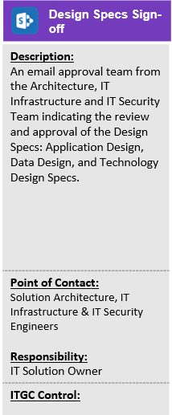
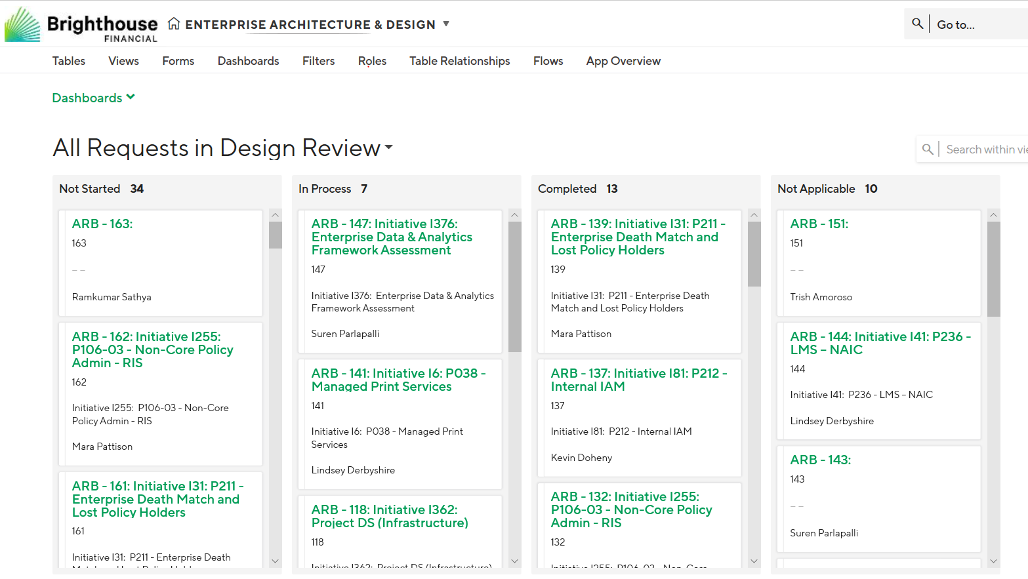
Design Review Process Who signs off and how are sign offs tracked?
Design Reviews-SIGN OFFS
Architects and partner providers provide verbal or email sign off on the design review meetings. Architects record design review status in the EA TrackVia site. TMO tracks SDLC design phase completion via toll gates.

Slide 25
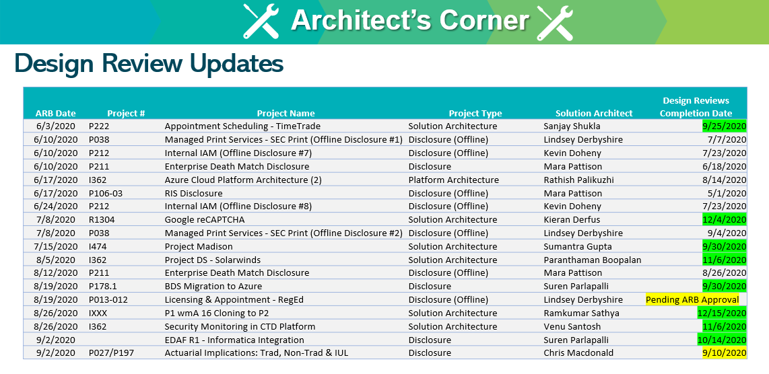
Design Review Process What reporting is provided?
Design Reviews-REPORTING
Design review metrics are shared by EA on the TMO meetings

Slide 26


